Slide 1

DIVINE GRACE COLLEGE OF ARTS, SCIENCE AND TECHNOLOGY
(DGCAST) — GAROUA | GEOGRAPHY DEPARTMENT
UPPER SIXTH ARTS — ENVIRONMENT AND DEVELOPMENT — LESSON 1
Pollution
Mr KAMDEM EMMANUEL
Geography Teacher — PLEG
Academic Year 2026 / 2027
Notes:
Good morning, class. Today we study Lesson 1: Pollution.

Slide 2
GEOGRAPHY — UPPER SIXTH ARTS
CLASS INFO
Class, Chapter & Duration
Class | Upper Sixth Arts
Chapter | Module 7: Understanding and managing contemporary environmental and development issues
Duration | 2 periods (2 × 50 minutes)
2026 / 2027
DGCAST GAROUA — GEOGRAPHY DEPARTMENT
Mr KAMDEM E. | 2

Slide 3
GEOGRAPHY — UPPER SIXTH ARTS
IDENTIFICATION
Lesson Identification
Topic | Contemporary Environmental Issues
Sub-topic | Environmental Degradation
Lesson | Lesson 1: Pollution
Notions / Concepts | Pollution, pollutant, acid rain, eutrophication, recycling.
Syllabus focus | Main types (water, air, land); meaning, pollutants and sources; nature and magnitude; causes; effects on people and the environment; solutions (legislation, technology, recycling, disposal, international cooperation).
Competence | Learners are able to identify types of pollution, explain their causes and effects and propose solutions.
2026 / 2027
DGCAST GAROUA — GEOGRAPHY DEPARTMENT
Mr KAMDEM E. | 3

Slide 4
GEOGRAPHY — UPPER SIXTH ARTS
OBJECTIVES
Learning Objectives
By the end of the lesson, the learner should be able to:
Define pollution and name its main types.
Explain the causes and effects of pollution.
Propose solutions to pollution.
2026 / 2027
DGCAST GAROUA — GEOGRAPHY DEPARTMENT
Mr KAMDEM E. | 4

Slide 5
GEOGRAPHY — UPPER SIXTH ARTS
RECALL
Recall
Factories and cars produce smoke.
Rubbish is thrown in drains and rivers.
2026 / 2027
DGCAST GAROUA — GEOGRAPHY DEPARTMENT
Mr KAMDEM E. | 5

Slide 6
GEOGRAPHY — UPPER SIXTH ARTS
REAL-LIFE SITUATION
Real-Life Situation
In Douala, plastic bags block the gutters, smoke from factories and old cars fills the air and some people drink water from polluted wells. Many children have coughs and diarrhoea.
2026 / 2027
DGCAST GAROUA — GEOGRAPHY DEPARTMENT
Mr KAMDEM E. | 6
Notes:
Read the situation slowly, twice.

Slide 7
GEOGRAPHY — UPPER SIXTH ARTS
REAL-LIFE SITUATION
Situation — Question 1
What is the problem in the situation?
2026 / 2027
DGCAST GAROUA — GEOGRAPHY DEPARTMENT
Mr KAMDEM E. | 7

Slide 8
GEOGRAPHY — UPPER SIXTH ARTS
REAL-LIFE SITUATION
Answer
Air, water and land are polluted.
2026 / 2027
DGCAST GAROUA — GEOGRAPHY DEPARTMENT
Mr KAMDEM E. | 8

Slide 9
GEOGRAPHY — UPPER SIXTH ARTS
REAL-LIFE SITUATION
Situation — Question 2
Give two sources of pollution in the situation.
2026 / 2027
DGCAST GAROUA — GEOGRAPHY DEPARTMENT
Mr KAMDEM E. | 9

Slide 10
GEOGRAPHY — UPPER SIXTH ARTS
REAL-LIFE SITUATION
Answer
Plastic waste and smoke from factories and cars.
2026 / 2027
DGCAST GAROUA — GEOGRAPHY DEPARTMENT
Mr KAMDEM E. | 10

Slide 11
GEOGRAPHY — UPPER SIXTH ARTS
REAL-LIFE SITUATION
Situation — Question 3
Give one effect on people.
2026 / 2027
DGCAST GAROUA — GEOGRAPHY DEPARTMENT
Mr KAMDEM E. | 11

Slide 12
GEOGRAPHY — UPPER SIXTH ARTS
REAL-LIFE SITUATION
Possible Answer
Coughs and diarrhoea.
2026 / 2027
DGCAST GAROUA — GEOGRAPHY DEPARTMENT
Mr KAMDEM E. | 12

Slide 13
GEOGRAPHY — UPPER SIXTH ARTS
JUSTIFICATION
Justification of the Lesson
This lesson helps us to understand pollution and to protect our health and environment.
2026 / 2027
DGCAST GAROUA — GEOGRAPHY DEPARTMENT
Mr KAMDEM E. | 13

Slide 14
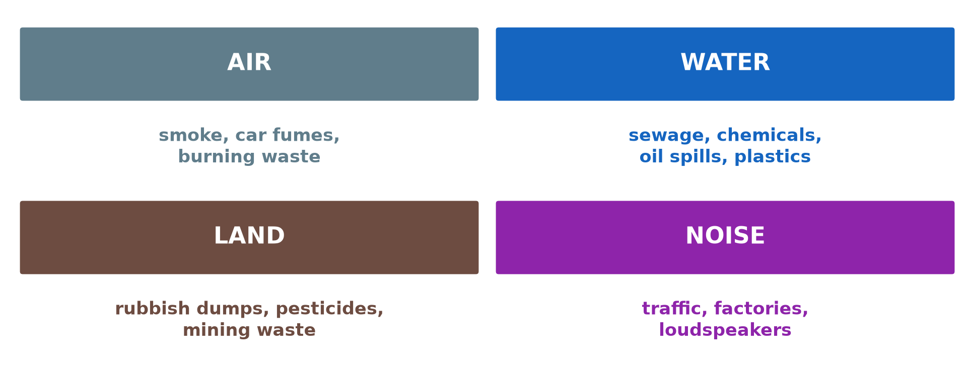
GEOGRAPHY — UPPER SIXTH ARTS
I. TYPES
Activity 1
The main types of pollution.
2026 / 2027
DGCAST GAROUA — GEOGRAPHY DEPARTMENT
Mr KAMDEM E. | 14
Notes:
Without the projector: list polluted places in your town.

Slide 15
GEOGRAPHY — UPPER SIXTH ARTS
I. TYPES
Activity 1: Question
Name the three main types of pollution.
2026 / 2027
DGCAST GAROUA — GEOGRAPHY DEPARTMENT
Mr KAMDEM E. | 15

Slide 16
GEOGRAPHY — UPPER SIXTH ARTS
I. TYPES
Answer
Air, water and land pollution (also noise).
2026 / 2027
DGCAST GAROUA — GEOGRAPHY DEPARTMENT
Mr KAMDEM E. | 16

Slide 17

GEOGRAPHY — UPPER SIXTH ARTS
II. AIR POLLUTION
Activity 2
Smoke from factory chimneys.
2026 / 2027
DGCAST GAROUA — GEOGRAPHY DEPARTMENT
Mr KAMDEM E. | 17
Notes:
Without the projector: describe smoke you see.

Slide 18
GEOGRAPHY — UPPER SIXTH ARTS
II. AIR POLLUTION
Activity 2: Question
Give two sources of air pollution.
2026 / 2027
DGCAST GAROUA — GEOGRAPHY DEPARTMENT
Mr KAMDEM E. | 18

Slide 19
GEOGRAPHY — UPPER SIXTH ARTS
II. AIR POLLUTION
Answer
Factories and car exhaust (also burning waste and bush fires).
2026 / 2027
DGCAST GAROUA — GEOGRAPHY DEPARTMENT
Mr KAMDEM E. | 19

Slide 20
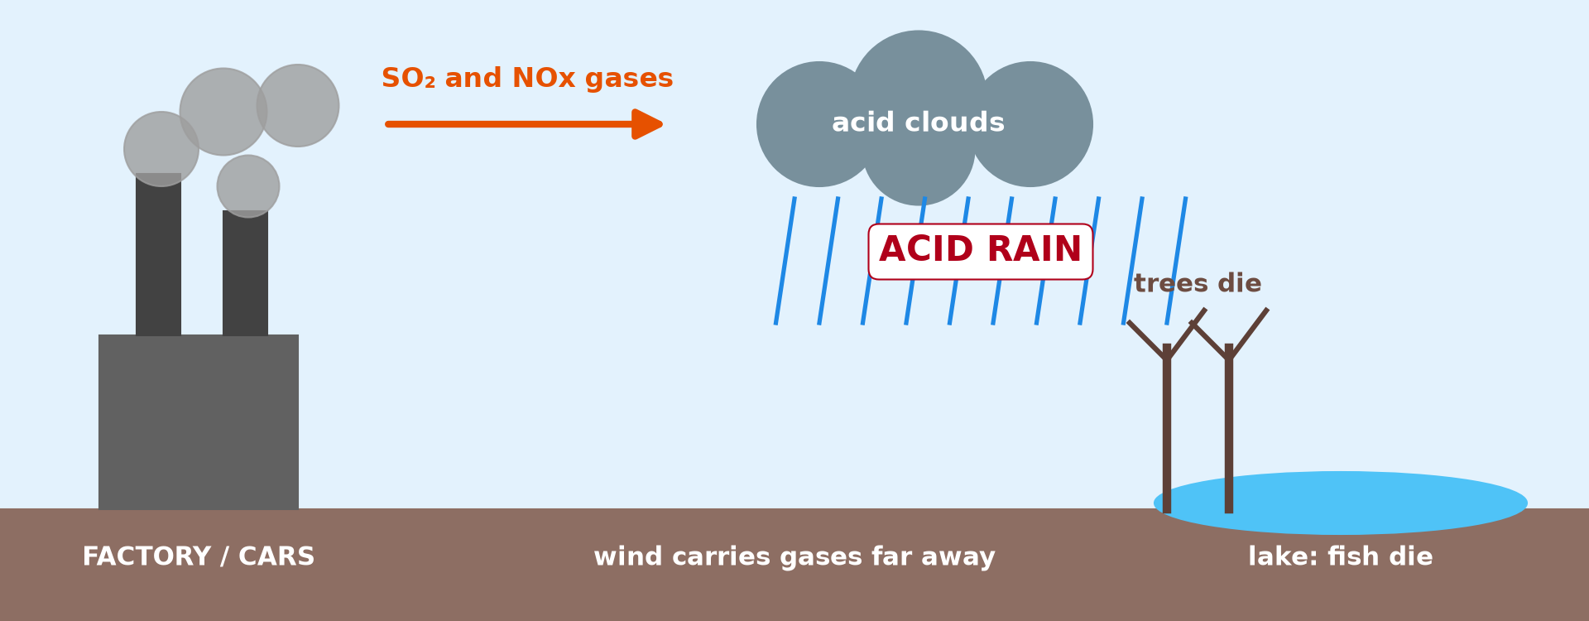
GEOGRAPHY — UPPER SIXTH ARTS
II. ACID RAIN
Activity 3
How acid rain forms.
2026 / 2027
DGCAST GAROUA — GEOGRAPHY DEPARTMENT
Mr KAMDEM E. | 20
Notes:
Without the projector: describe the steps.

Slide 21
GEOGRAPHY — UPPER SIXTH ARTS
II. ACID RAIN
Activity 3: Question
Explain how acid rain forms.
2026 / 2027
DGCAST GAROUA — GEOGRAPHY DEPARTMENT
Mr KAMDEM E. | 21

Slide 22
GEOGRAPHY — UPPER SIXTH ARTS
II. ACID RAIN
Answer
Sulphur and nitrogen gases mix with water in clouds and fall as acid rain.
2026 / 2027
DGCAST GAROUA — GEOGRAPHY DEPARTMENT
Mr KAMDEM E. | 22

Slide 23
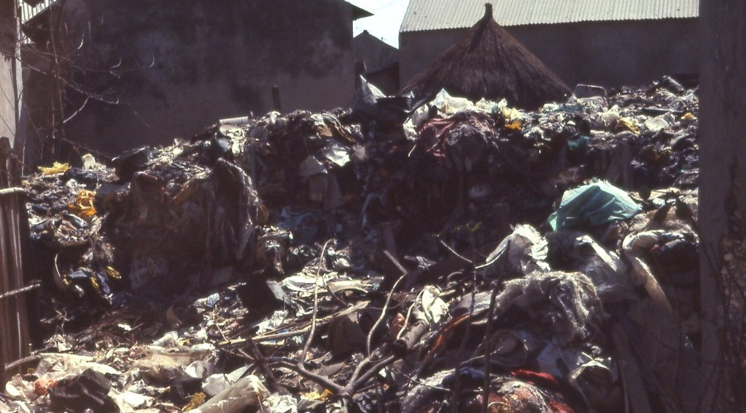
GEOGRAPHY — UPPER SIXTH ARTS
III. WATER AND LAND
Activity 4
A rubbish dump in West Africa.
2026 / 2027
DGCAST GAROUA — GEOGRAPHY DEPARTMENT
Mr KAMDEM E. | 23
Notes:
Without the projector: discuss rubbish in your area.

Slide 24
GEOGRAPHY — UPPER SIXTH ARTS
III. WATER AND LAND
Activity 4: Question
Give two effects of rubbish dumps.
2026 / 2027
DGCAST GAROUA — GEOGRAPHY DEPARTMENT
Mr KAMDEM E. | 24

Slide 25
GEOGRAPHY — UPPER SIXTH ARTS
III. WATER AND LAND
Answer
They pollute water and soil and spread diseases like cholera.
2026 / 2027
DGCAST GAROUA — GEOGRAPHY DEPARTMENT
Mr KAMDEM E. | 25

Slide 26
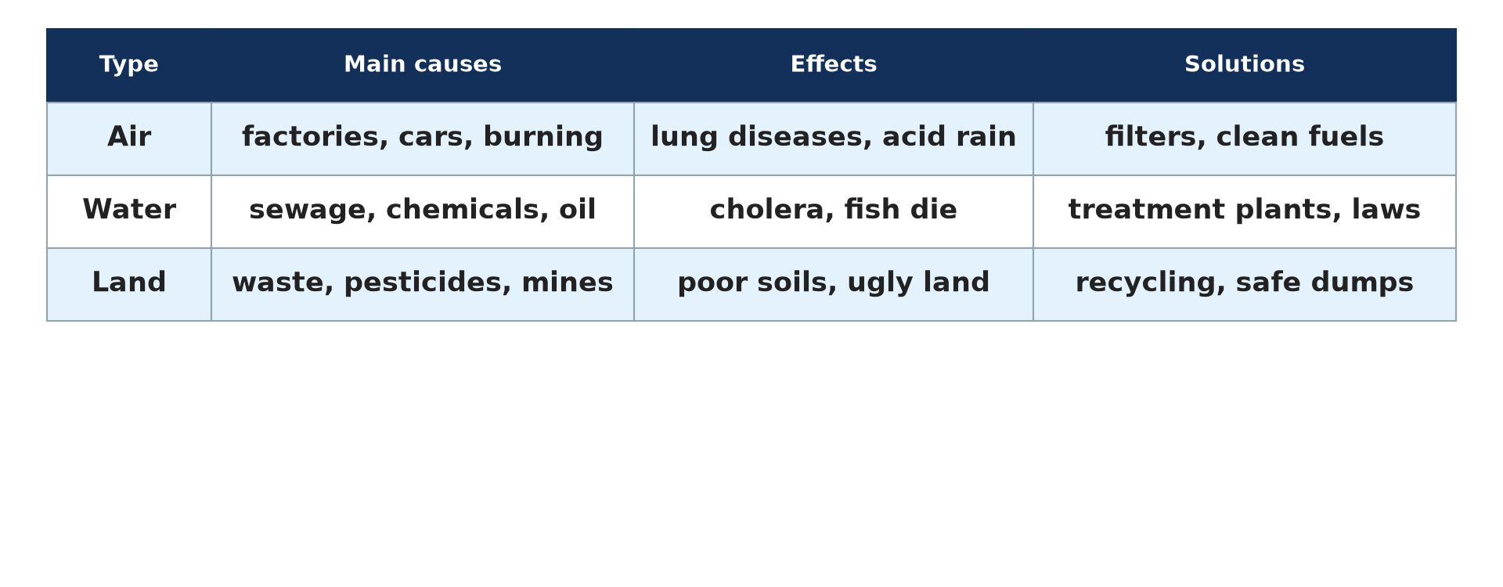
GEOGRAPHY — UPPER SIXTH ARTS
IV. SOLUTIONS
Activity 5
Causes, effects and solutions.
2026 / 2027
DGCAST GAROUA — GEOGRAPHY DEPARTMENT
Mr KAMDEM E. | 26
Notes:
Without the projector: suggest solutions for your school.

Slide 27
GEOGRAPHY — UPPER SIXTH ARTS
IV. SOLUTIONS
Activity 5: Question
Give three solutions to pollution.
2026 / 2027
DGCAST GAROUA — GEOGRAPHY DEPARTMENT
Mr KAMDEM E. | 27

Slide 28
GEOGRAPHY — UPPER SIXTH ARTS
IV. SOLUTIONS
Answer
Recycling, laws against dumping and treatment plants (also clean technology).
2026 / 2027
DGCAST GAROUA — GEOGRAPHY DEPARTMENT
Mr KAMDEM E. | 28

Slide 29
GEOGRAPHY — UPPER SIXTH ARTS
BOARD SUMMARY
Pollution
Topic: Contemporary Environmental Issues
Sub-topic: Environmental Degradation
Lesson 1: Pollution
2026 / 2027
DGCAST GAROUA — GEOGRAPHY DEPARTMENT
Mr KAMDEM E. | 29
Notes:
Learners copy the board summary now. Give them enough time for each slide.

Slide 30
GEOGRAPHY — UPPER SIXTH ARTS
BOARD SUMMARY
I. Definitions
Pollution: It is the addition of harmful substances to air, water or land.
Pollutant: It is a substance that causes pollution, like smoke or plastic.
Eutrophication: It is the excess growth of algae in water caused by fertilisers and sewage.
2026 / 2027
DGCAST GAROUA — GEOGRAPHY DEPARTMENT
Mr KAMDEM E. | 30

Slide 31
GEOGRAPHY — UPPER SIXTH ARTS
BOARD SUMMARY
II. Types and Causes (1/3)
A. Air pollution: Smoke from factories, cars and burning waste pollutes the air. It causes acid rain and lung diseases.
B. Water pollution: Sewage, chemicals, oil spills and plastics pollute rivers and seas. Fish die and people catch cholera.
2026 / 2027
DGCAST GAROUA — GEOGRAPHY DEPARTMENT
Mr KAMDEM E. | 31

Slide 32
GEOGRAPHY — UPPER SIXTH ARTS
BOARD SUMMARY
II. Types and Causes (2/3)
C. Land pollution: Rubbish dumps, pesticides and mining waste damage soils. Population growth and industry increase the problem.
2026 / 2027
DGCAST GAROUA — GEOGRAPHY DEPARTMENT
Mr KAMDEM E. | 32

Slide 33
GEOGRAPHY — UPPER SIXTH ARTS
BOARD SUMMARY
II. Types and Causes (3/3)
Copy the acid rain diagram.
2026 / 2027
DGCAST GAROUA — GEOGRAPHY DEPARTMENT
Mr KAMDEM E. | 33

Slide 34
GEOGRAPHY — UPPER SIXTH ARTS
BOARD SUMMARY
III. Effects and Solutions
A. Effects: Pollution causes diseases, kills wildlife and damages buildings and soils. It also lowers crop yields.
B. Solutions: Laws, clean technology, recycling and safe waste disposal reduce pollution. International agreements help for global problems.
2026 / 2027
DGCAST GAROUA — GEOGRAPHY DEPARTMENT
Mr KAMDEM E. | 34

Slide 35
GEOGRAPHY — UPPER SIXTH ARTS
FORMATIVE EVALUATION
Formative Evaluation 1
Give two causes and two effects of water pollution.
2026 / 2027
DGCAST GAROUA — GEOGRAPHY DEPARTMENT
Mr KAMDEM E. | 35

Slide 36
GEOGRAPHY — UPPER SIXTH ARTS
FORMATIVE EVALUATION
Expected Answer
Causes: sewage, chemicals. Effects: cholera, fish die.
2026 / 2027
DGCAST GAROUA — GEOGRAPHY DEPARTMENT
Mr KAMDEM E. | 36

Slide 37
GEOGRAPHY — UPPER SIXTH ARTS
FORMATIVE EVALUATION
Formative Evaluation 2
Give three measures to reduce pollution.
2026 / 2027
DGCAST GAROUA — GEOGRAPHY DEPARTMENT
Mr KAMDEM E. | 37

Slide 38
GEOGRAPHY — UPPER SIXTH ARTS
FORMATIVE EVALUATION
Expected Answer
Recycling, laws and treatment plants.
2026 / 2027
DGCAST GAROUA — GEOGRAPHY DEPARTMENT
Mr KAMDEM E. | 38

Slide 39
GEOGRAPHY — UPPER SIXTH ARTS
REMEDIATION
Remediation
Fill in the blanks:
Rain made acid by factory gases is ______ rain.
Algae growth caused by fertilisers is ______.
Using waste again is ______.
2026 / 2027
DGCAST GAROUA — GEOGRAPHY DEPARTMENT
Mr KAMDEM E. | 39
Notes:
Answers: 1. acid 2. eutrophication 3. recycling

Slide 40
GEOGRAPHY — UPPER SIXTH ARTS
HOMEWORK
Homework
List the sources of pollution around your home and suggest one solution for each.
This prepares Lesson 2: Deforestation and Desertification.
2026 / 2027
DGCAST GAROUA — GEOGRAPHY DEPARTMENT
Mr KAMDEM E. | 40
Notes:
This homework prepares the next lesson.

Slide 41
GEOGRAPHY — UPPER SIXTH ARTS
BILINGUAL GAME
Bilingual Game (Jeu Bilingue)
English | Français
Pollution | La pollution
Waste | Les déchets
Smoke | La fumée
Sewage | Les eaux usées
Recycling | Le recyclage
Acid rain | Les pluies acides
2026 / 2027
DGCAST GAROUA — GEOGRAPHY DEPARTMENT
Mr KAMDEM E. | 41
Notes:
Say the English word; learners give the French word, then the reverse.

Slide 42
GEOGRAPHY — UPPER SIXTH ARTS
LOGBOOK
Official Logbook (1/2)
Module / Topic | Contemporary Environmental Issues
Lesson Title | Lesson 1: Pollution
Expected Learning Outcomes | Define pollution and name its main types. Explain the causes and effects of pollution. Propose solutions to pollution.
Competence | Learners are able to identify types of pollution, explain their causes and effects and propose solutions.
2026 / 2027
DGCAST GAROUA — GEOGRAPHY DEPARTMENT
Mr KAMDEM E. | 42

Slide 43
GEOGRAPHY — UPPER SIXTH ARTS
LOGBOOK
Official Logbook (2/2)
Matter Taught | I. Definitions: Pollution, Pollutant, Eutrophication; II. Types and Causes: Air pollution, Water pollution, Land pollution; III. Effects and Solutions: Effects, Solutions.
Evaluation | Formative evaluation (3 questions) and remediation exercise.
Homework | List the sources of pollution around your home and suggest one solution for each.
Enrolment / Present / Absent | ____ / ____ / ____
Achievement | To be completed by the teacher after the lesson.
2026 / 2027
DGCAST GAROUA — GEOGRAPHY DEPARTMENT
Mr KAMDEM E. | 43

Slide 44
GEOGRAPHY — UPPER SIXTH ARTS
TEACHER'S NOTE
Teacher's Note
Timing: Set-up, recall 8 min | Situation 8 min | 5 activities 30 min | Board summary (copying) 30 min | Evaluation, remediation 10 min | Homework, logbook 9 min | Spare 5 min
2026 / 2027
DGCAST GAROUA — GEOGRAPHY DEPARTMENT
Mr KAMDEM E. | 44

Slide 45
GEOGRAPHY — UPPER SIXTH ARTS
REFERENCES
References
National Geography Syllabus, Sixth Forms (Lower & Upper Sixth), MINESEC/IGE/IP-SS, August 2019 — Module 7 (Environment and Development).
Photo, Activity 2: “image replaced (thanks Anne :) )” by why 137, CC BY 2.0, via Flickr (https://www.flickr.com/photos/78752351@N03/8464430910)
Photo, Activity 4: “Garbage dump at Fadiouth, Senegal (West Africa)” by gbaku, CC BY-SA 2.0, via Flickr (https://www.flickr.com/photos/72105154@N00/906659197)
Diagrams and animations: drawn for this lesson (DGCAST Geography Department).
2026 / 2027
DGCAST GAROUA — GEOGRAPHY DEPARTMENT
Mr KAMDEM E. | 45

